Slide 1
web dev training
Working with Github and getting started with mean

Slide 2
Agenda
Working with GitHub (akos)
What is MEAN? (stefanos)
Create a MEAN skeleton and push it
Next steps
Notes:
Before we dig into the code. I would like to illustrate two fundamental concepts when loading a web content.
The first is to load the hole web page from the web server. The second an nowadays more popular approach to load and update only parts of the web app.

Slide 3
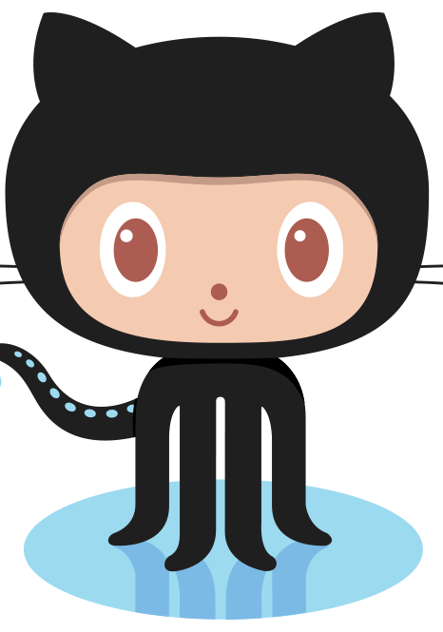
Working with GitHub

Slide 4

MEAN is…
Notes:
Jack Nicholson: One Flew Over The Cuckoo’s Nest

Slide 5

Ok, now for real…
MongoDB
Express
AngularJS
NodeJS
MEAN
MEAN is fullstack framework
–
which simplifies and accelerates web application development

Slide 6
Why do I care?
same language and objects (JS, JSON)
easy and flexible data validation with MongoDB (and Mangoose)
never need threads with NodeJS
package manager similar to Rails gems or Nuget
dynamic client-side templates with AngularJS (two-way binding)

Slide 7





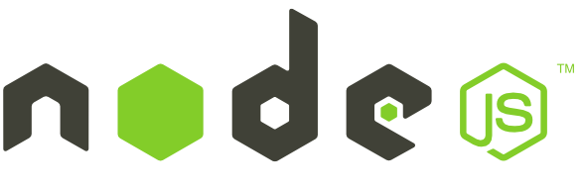
The stack data pipeline
1. request/push data
2. get/write JSON
3. serves data (REST API)

Slide 8
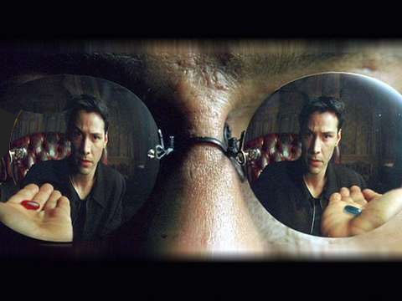
You have the choice...
Notes:
Red: painful truth of reality
Blue: blissful ignorance of illusion

Slide 9
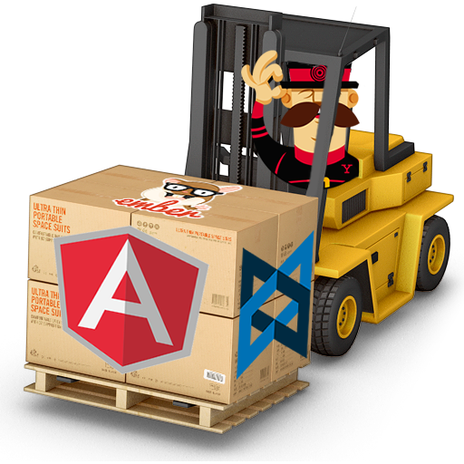
You made the right decision…
Notes:
The web´s scaffolding tool for modern webapps
Prerequisites!!!
Slightly different tool called: mean.io

Slide 10

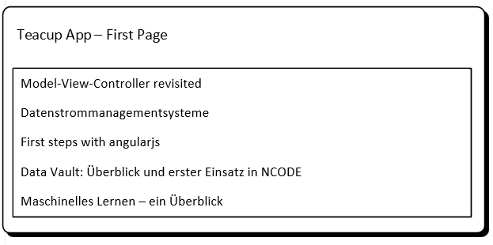
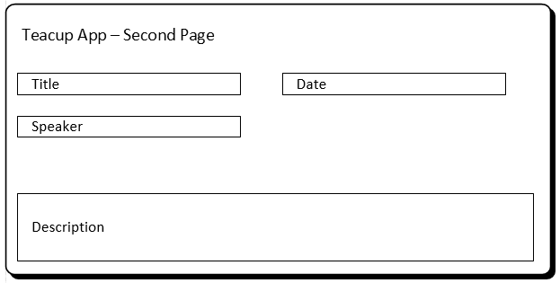
Next steps
join your prefered tech team
get familiar with the application skeleton
we will organize the features on GitHub (Wiki)
implement the list & detail until next meetup

